Slide 1
Book Library

Slide 2
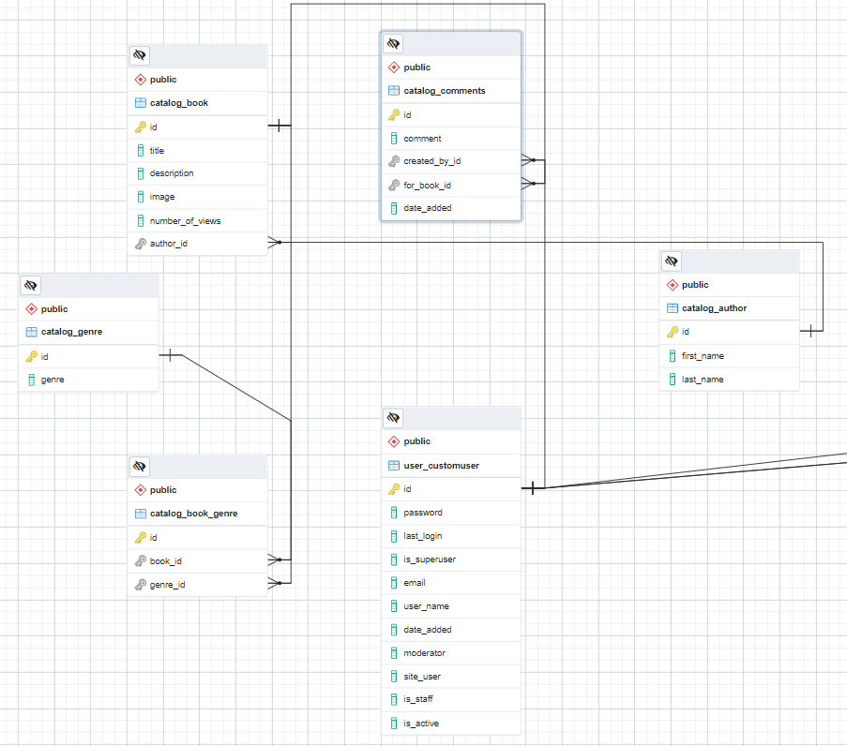
Database diagram

Slide 3
Use cases
Sign Up
Guest
View Books
Search Books
Edit Book
Site user
View Book details
Delete
Book
Login/Logout
Comment
Moderator
Delete Comment
Add Author
Add Book
Manage Users
Admin
Add genre

Slide 4
Technology stack
Programming back-end Language: Python v3.10.3
Programming front-end Language: HTML5, CSS3
IDE: PyCharm
Data Storage: PosgreSQL(psycopg2 v2.9.3)
Back-end framework: Django v4.0.3
Front-end framework: Bootstrap3 v21.2
Version control: Git

